Slide 1
Computer Vision: Looking Back to Look Forward
image source
Svetlana Lazebnik
IRIM Short Course
Spring 2020

Slide 2
Outline of lectures
Tues. 1/28: Where are we going, where have we been?
Wed. 1/29: Stepping back: What is the nature of visual perception?
Thurs. 1/30: History of ideas in recognition – Part I
Tues. 2/4: History of ideas in recognition – Part II – TSRB banquet hall
Wed. 2/5: Emerging trends – or, what should we be working on?
Thurs. 2/6: Ethical issues for computer vision researchers

Slide 3
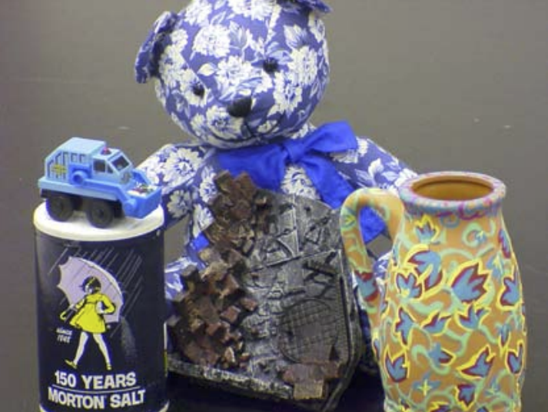
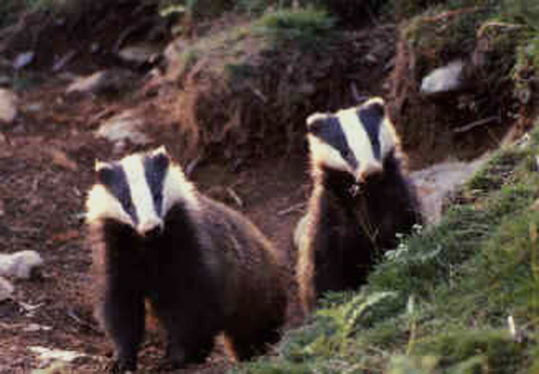
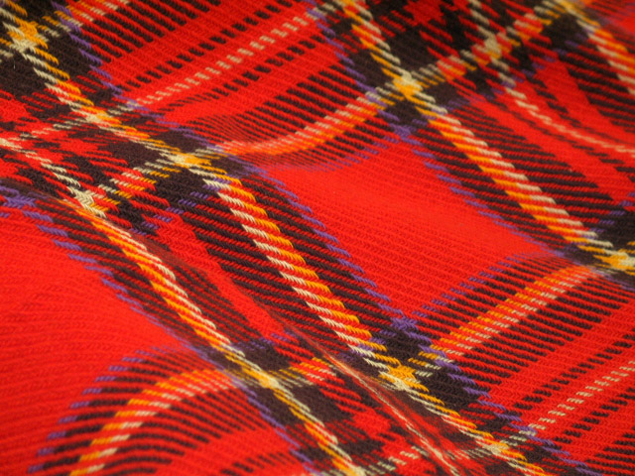

History of Recognition: Outline
Object instance recognition
Object category recognition
Texture recognition
Scene recognition

Slide 4
History of Recognition: Outline
Object instance recognition
3D geometric
Blocks world
Alignment
Aspect graphs
Invariants
Primitive-based approaches: generalized cylinders, geons
Appearance-based
Eigenfaces
Appearance manifolds
Color indexing
Keypoint-based
Schmid & Mohr
Lowe
Video Google
Texture recognition
Textons
Filter banks
Histograms
Object category recognition
Pictorial structures
Early statistical: Late 90s face detectors
Constellation models
Bags of features
HOG, DPMs
Scene recognition
Early knowledge-based
GIST
Bags of features, pyramids

Slide 5
1970
1980
1990
2000
Alignment
Invariants
Instances
Aspect graphs
Keypoints
Generalized cylinders
SIFT
Video Google
Appearance models
Misc. statistics
Textures
Textons
Filter banks
Texton histograms
Bags of features
Deformable templates
Pictorial structures
Probabilistic models
Constellation models
DPM
Object categories
Features & classifiers
HOG
Implicit shape models
Bags of features
Pyramids
Scenes
Knowledge-based approaches
GIST
Semantic segmentation
Duda & Hart
“Patterns”
Neocognitron
LeCun et al. digit rec.
LeNet-5
Back-propagation
Caltech-4
Caltech-101
ImageNet
Datasets
MNIST
Face datasets
PASCAL VOC

Slide 6
History of Recognition: Outline
Object instance recognition
Object category recognition
Texture recognition
Scene recognition

Slide 7
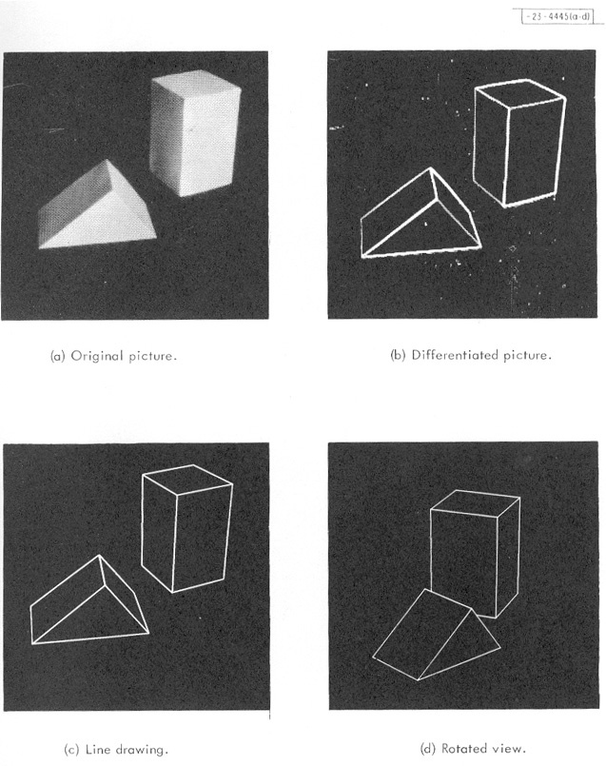
Recognizing known, rigid 3D objects
Recognition as inverse graphics
Ignore image intensities, focus on edges or point features
Main problem is alignment, or estimation of object pose that would give rise to projected image
Roberts (1963)
J. Mundy, Object recognition in the geometric era: A retrospective, 2006

Slide 8
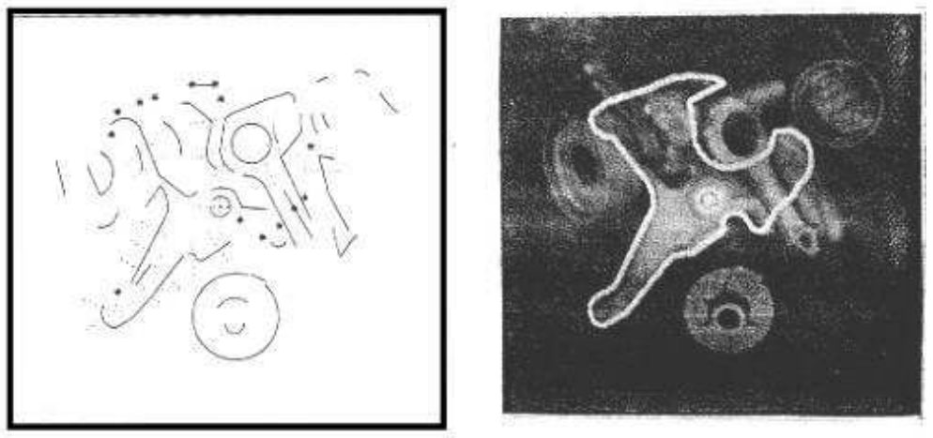
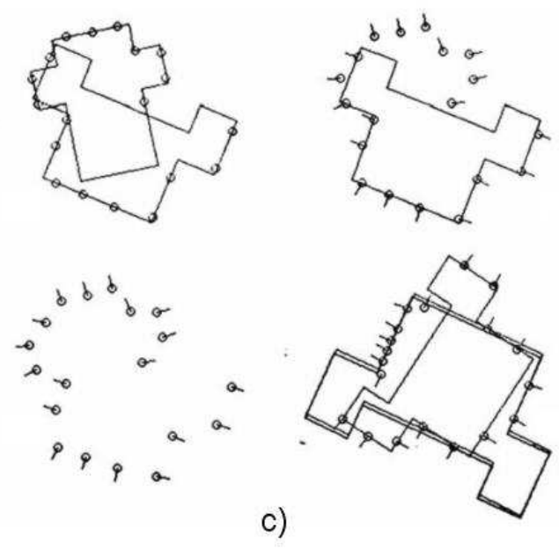
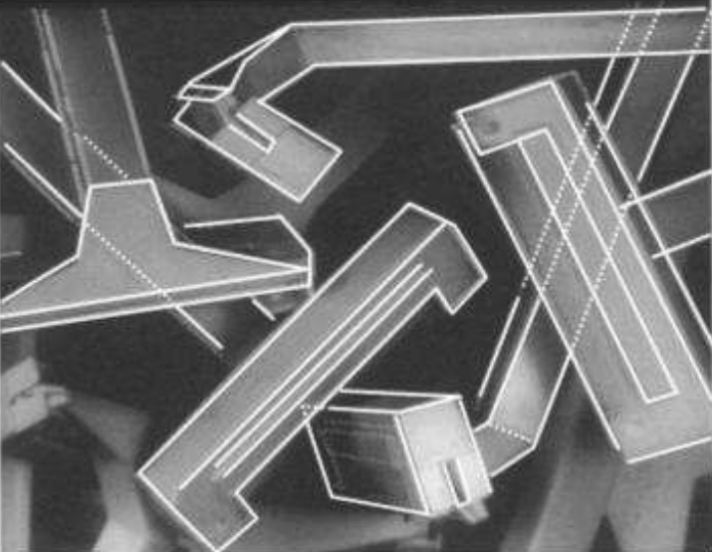
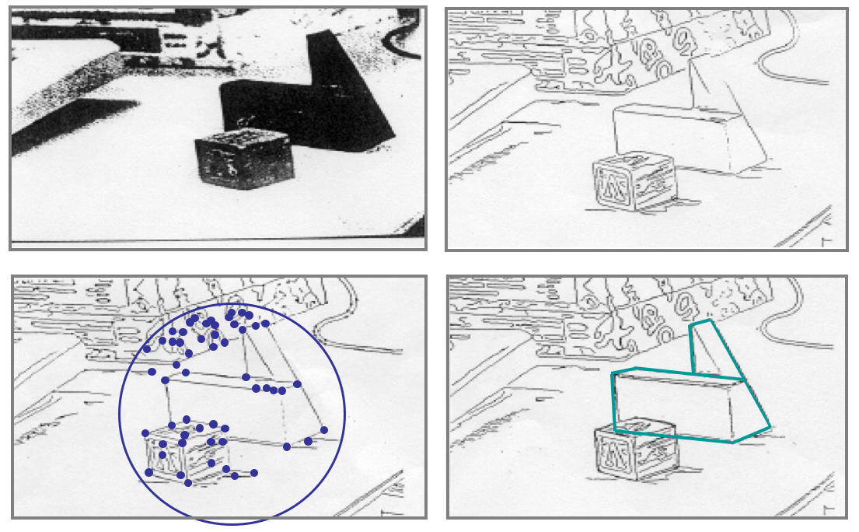
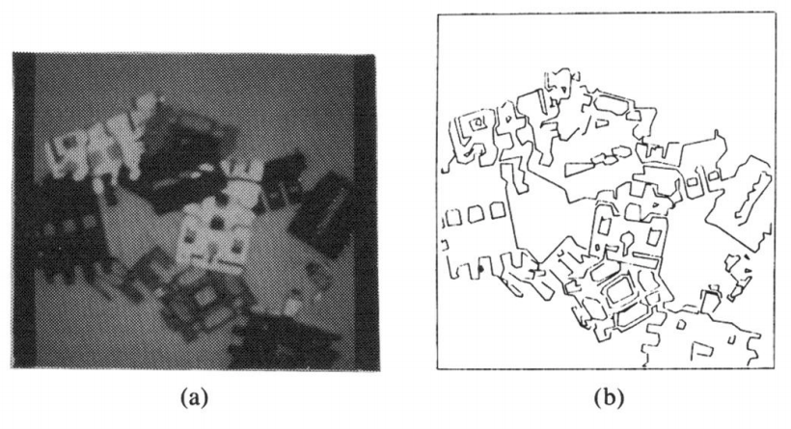
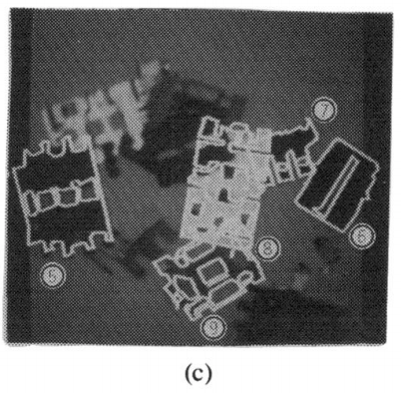
Model-based methods: Alignment
Perkins (1978)
Lowe (1985)
Grimson & Lozano-Perez (1984)
Ayache & Faugeras (1986)
Huttenlocher & Ullman (1987)

Slide 9
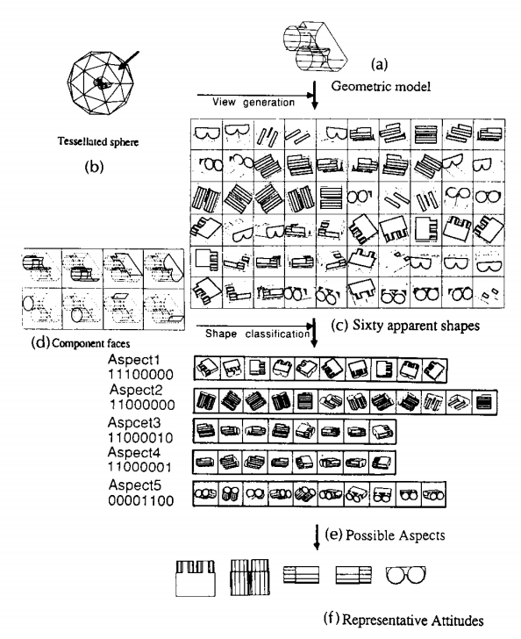
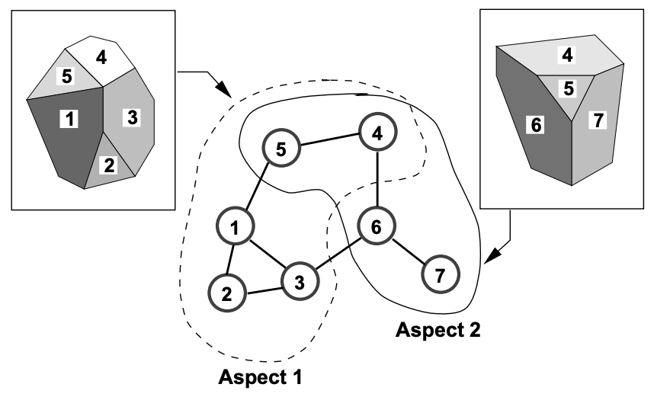
View-based methods: Aspect graphs
Mundy (2006)
Ikeuchi & Kanade (1988)
Koenderink & Van Doorn (1976, 1979), Plantinga & Dyer (1986), Hebert & Kanade (1985), Ikeuchi & Kanade (1988),
Gigus & Malik (1990)
Notes:
From Mundy: The nodes of the graph represent
object views that are adjacent to each other on the unit sphere of viewing di-
rections but differ in some significant way. The most common view relationship
in aspect graphs is based on the topological structure of the view, i.e., edges in
the aspect graph arise from transitions in the graph structure relating vertices,
edges and faces of the projected object.
It was shown by Harry Plantinga and Charles
Dyer [60] that under perspective viewing that the size of polyhedral aspect
graphs can grow as rapidly as n^9.

Slide 10
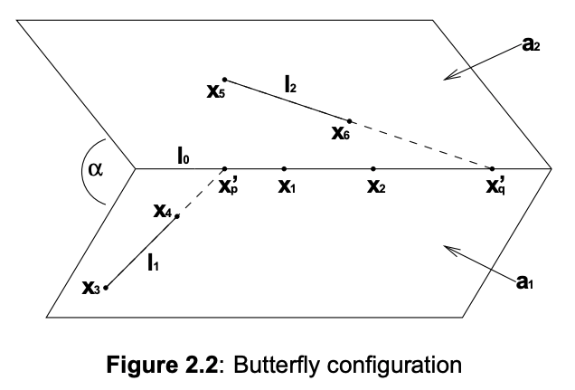
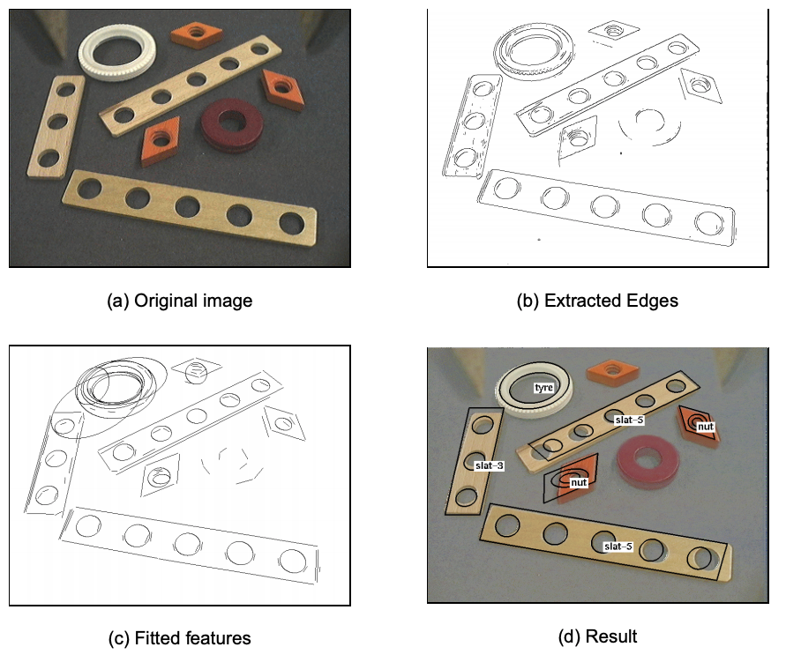
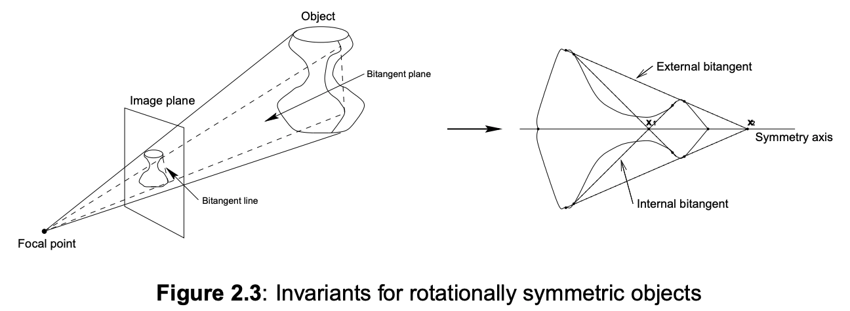
“Model-free” methods: Invariants
Examples of model features used to compute invariants
Figure source
J. Mundy and A. Zisserman (eds.), Geometric Invariance in Computer Vision, 1992

Slide 11
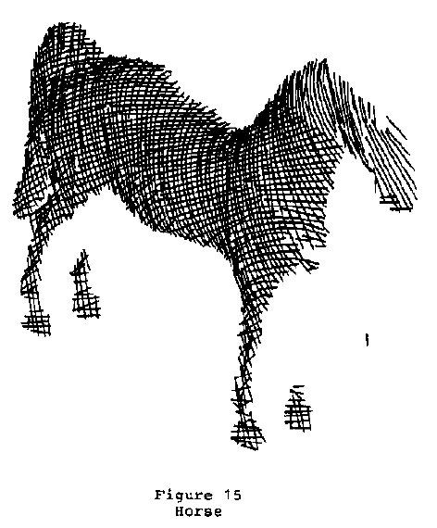
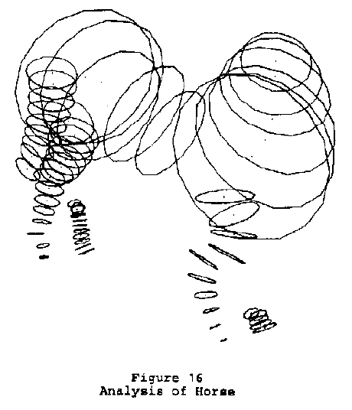
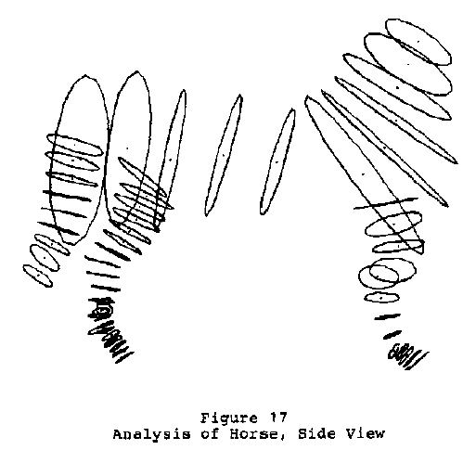


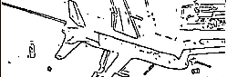

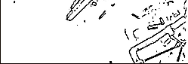

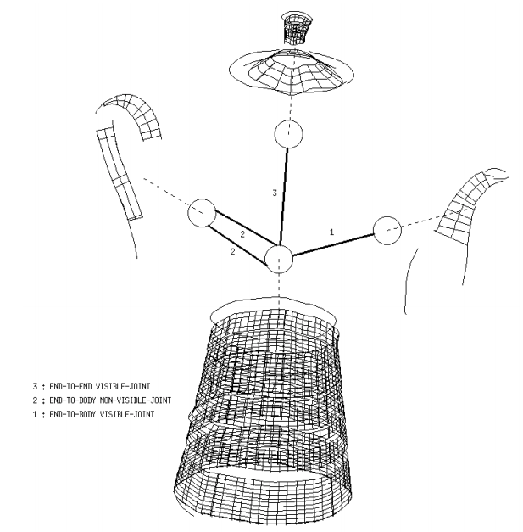
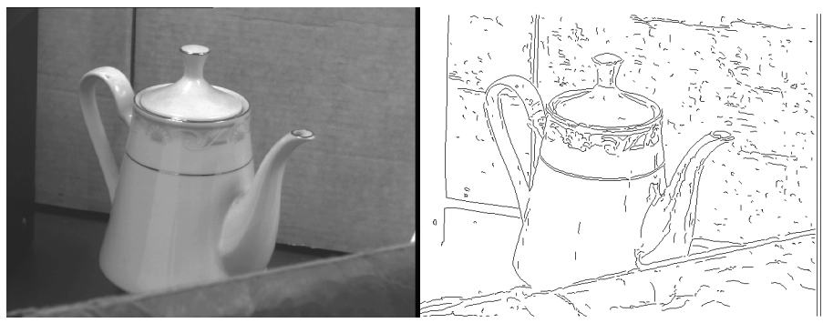
3D shape primitives: Generalized cylinders
Binford (1971), Agin & Binford (1973)
Brooks (1981)
Zerroug & Nevatia (1994)
Zisserman et al. (1995)
Notes:
From Mundy: Another Binford student, Rodney Brooks, developed a recognition system based
on symbolic geometric constraints on objects composed of GC parts [13]. The sys-
tem could essentially prove theorems concerning the existence of a parameterized
GC configuration with associated tolerances. The system was called ACRONYM
to avoid deriving a contrived name for the system, since ACRONYM is cleverly
self-referential 2. The Defense Advanced Projects Agency (DARPA) and the Cen-
tral Intelligence Agency (CIA) established a classified project to use ACRONYM
to recognize targets such as submarines as illustrated in Figure 5. The goal was
to assist strategic intelligence analysts that monitor military installations using
aerial photography. The project, called SCORPIUS, was designed to exploit var-
ious parallel computing architectures developed by DARPA in conjunction with
the Strategic Computing Program (1983-1993) [65]. Since the SCORPIUS pro-
gram was classified, it is not clear how effectively the ACRONYM recognition
system performed. The results must have been encouraging enough since a new
project, called RADIUS, was launched in 1993 with similar application goals [25].
However, the emphasis of RADIUS was on change detection and automated 3-d
modeling from imagery rather than recognition.

Slide 12
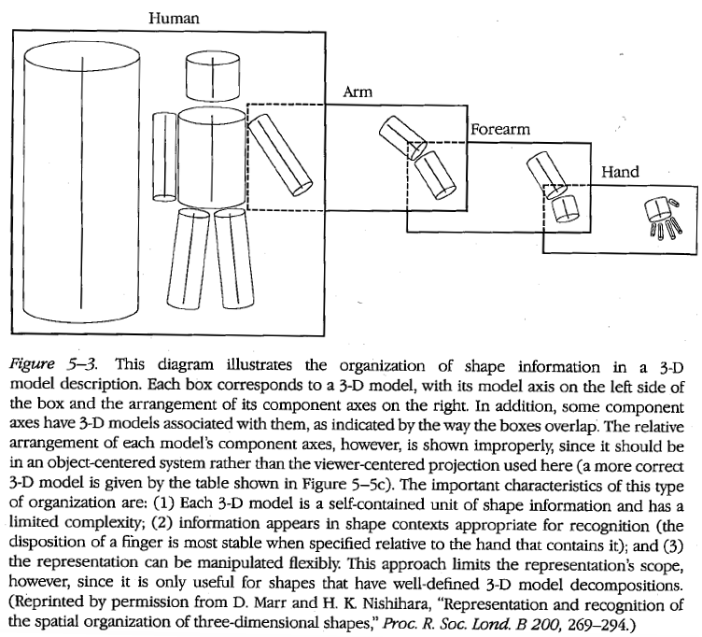
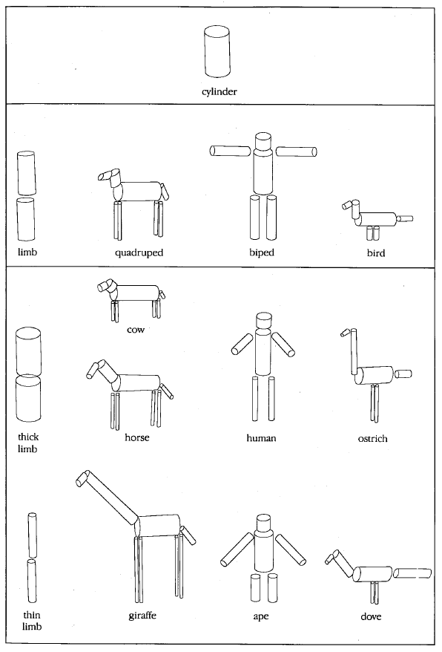
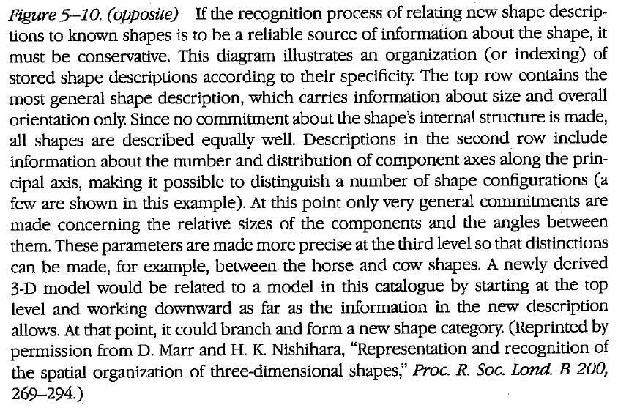
Marr’s 3D object representation
Marr & Nishihara (1978)

Slide 13
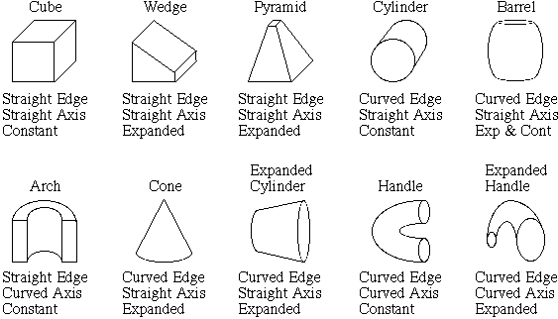
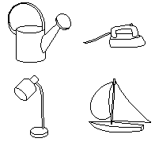
Psychological theory: Recognition by components
Primitives (geons)
Objects
Biederman (1987)
http://en.wikipedia.org/wiki/Recognition_by_Components_Theory

Slide 14
1970
1980
1990
2000
Alignment
Invariants
Instances
Aspect graphs
Generalized cylinders

Slide 15
Geometric recognition: Discussion
Summary
Emphasis on 3D modeling was sign of “right” thinking
People liked the math, combinatorics involved in reasoning about 3D shape, invariants, and aspect graphs
For rigid objects, some robustness to occlusion, viewpoint change was achieved
Practical applications in industrial inspection, robotics, target recognition
Recognition by components conceptually appealing, gave rise to supporting theories in cognitive science
What went wrong?
There was no reliable way to establish matches between model and image features
Numerical pose estimation techiques were not mature enough?
Nobody knew how to or compute part decompositions of general categories or model intra-class variations of 3D shape

Slide 16
Today: Revival of 3D primitives?
“Here we do not wish to reprise the classic debates on the value of volumetric primitives – while they were oversold in the 70s and 80s, they suffer from complete neglect now, and we hope that this demonstration of feasibility of learning how to assemble an object from volumetric primitives will reignite interest.”
S. Tulsiani, H. Su, L. Guibas, A. Efros, J. Malik, Learning Shape Abstractions by Assembling Volumetric Primitives, CVPR 2017

Slide 17
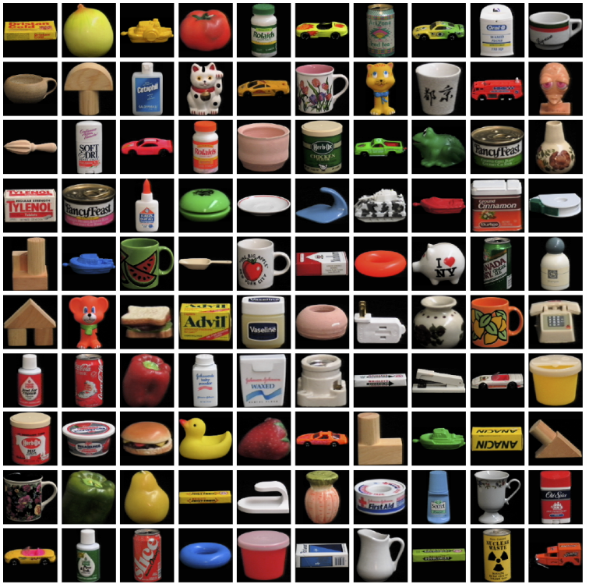
Appearance-based instance recognition
Maybe grayscale (or color) images are not as scary as they seem?
COIL-100 Dataset

Slide 18
Color histograms
M. Swain and D. Ballard, Color Indexing, IJCV 1991

Slide 19
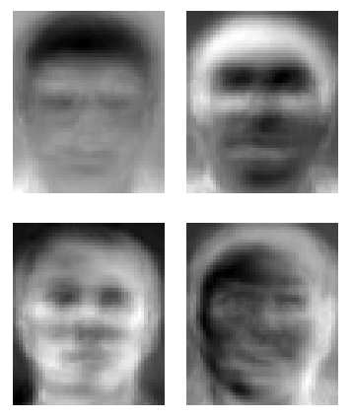
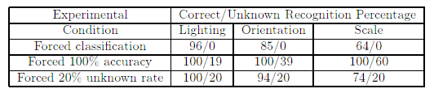
Eigenfaces
M. Turk and A. Pentland, Face recognition using eigenfaces, CVPR 1991

Slide 20
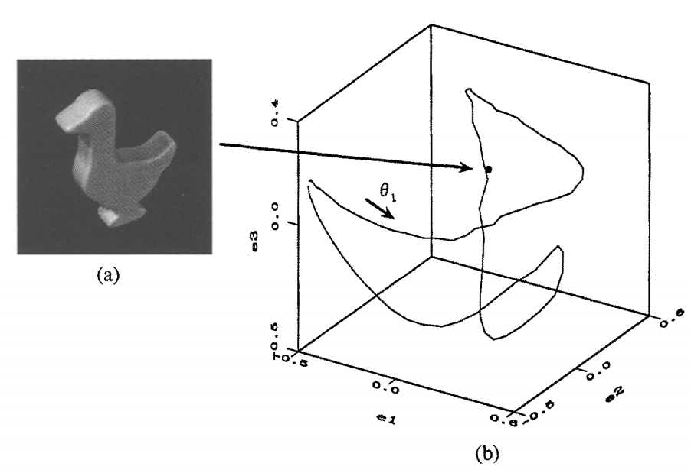
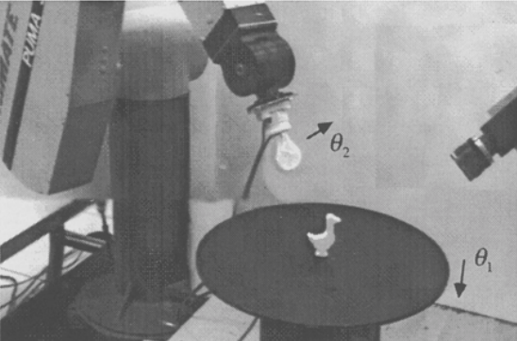
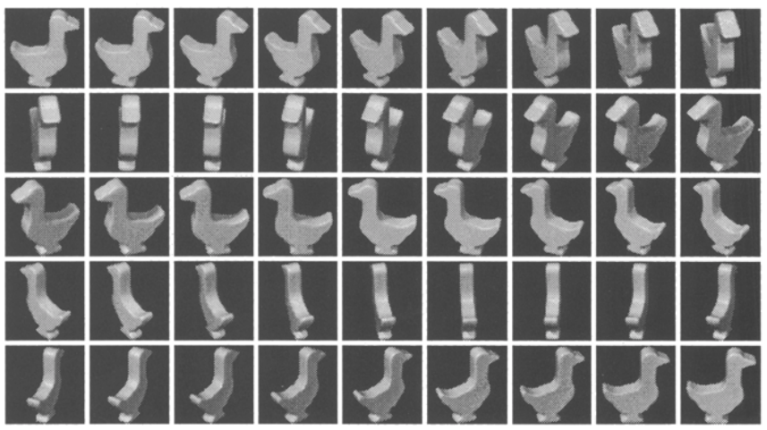
Appearance manifolds
Recognition demo movie
H. Murase and S. Nayar, Visual learning and recognition of 3-d objects from appearance, IJCV 1995
J. Mundy et al., An Experimental Comparison of Appearance and Geometric Model Based Recognition, 1996

Slide 21
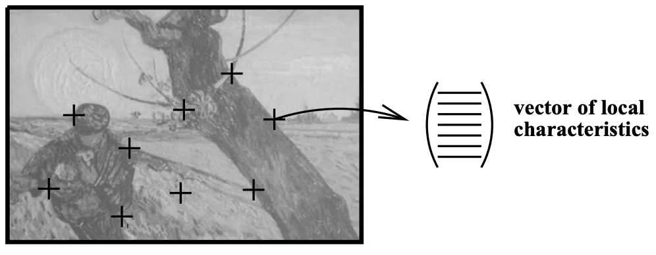
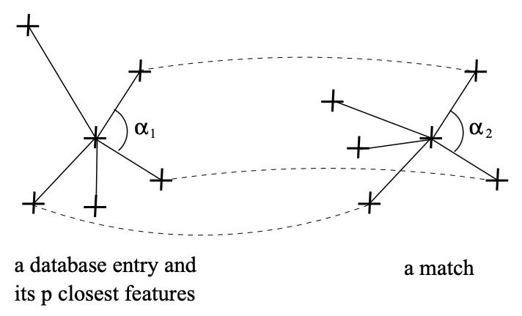
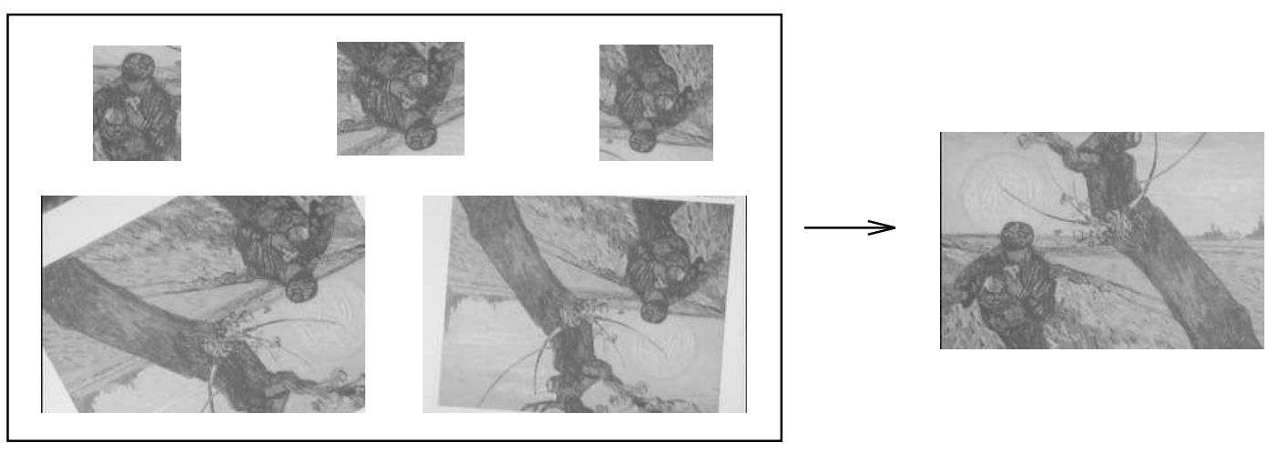
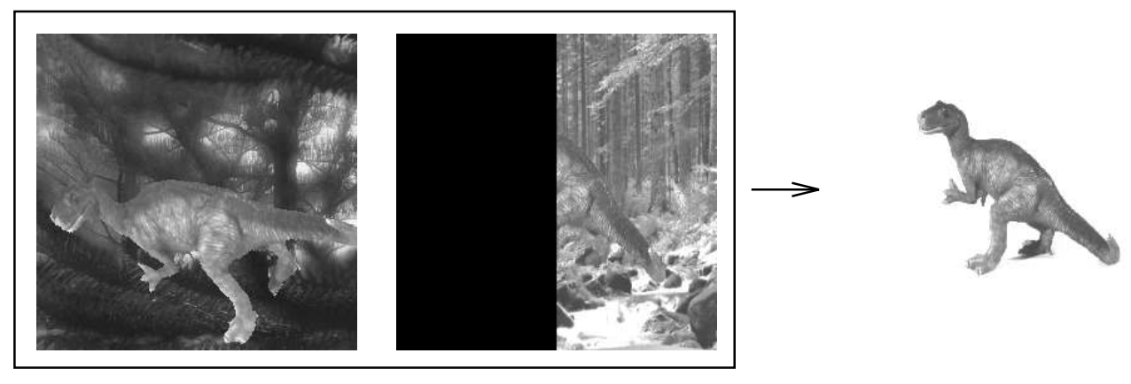
Keypoints + local appearance
Keypoints: corners (Harris & Stephens, 1988)
Descriptors: Local jets (Koenderink & Van Doorn, 1987)
C. Schmid & R. Mohr, Local grayvalue invariants for image retrieval, IEEE Trans. PAMI, 1996

Slide 22
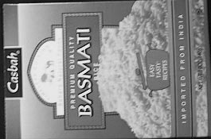
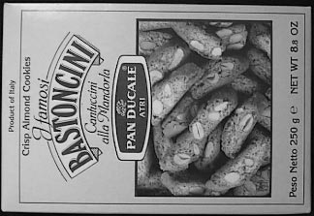

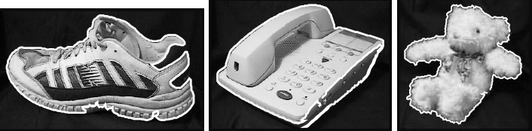
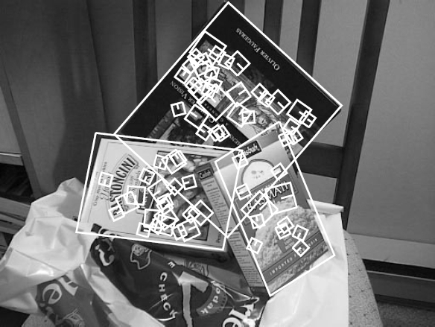
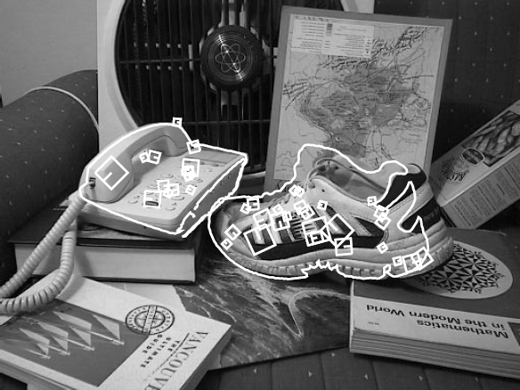
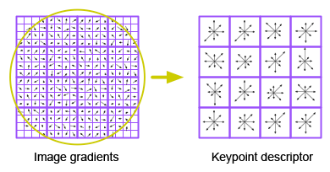
Scale-invariant feature transform (SIFT)
Figure from Mikolajczyk & Schmid (2004)
D. Lowe, Object recognition from local scale-invariant features, ICCV 1999
D. Lowe, Distinctive image features from scale-invariant keypoints, IJCV 2004

Slide 23
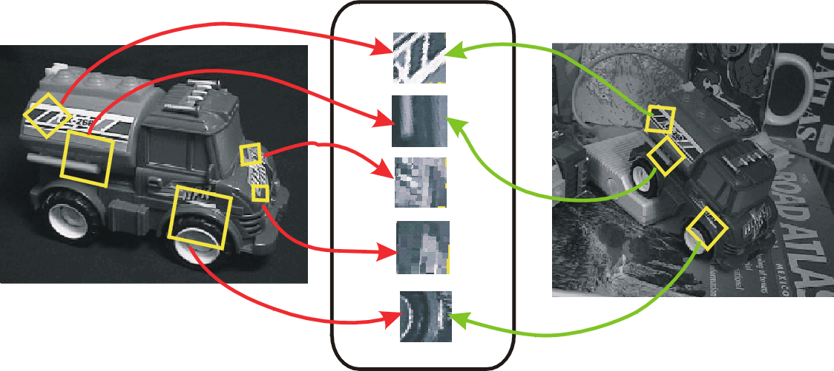
Covariant keypoints + invariant descriptors

Slide 24
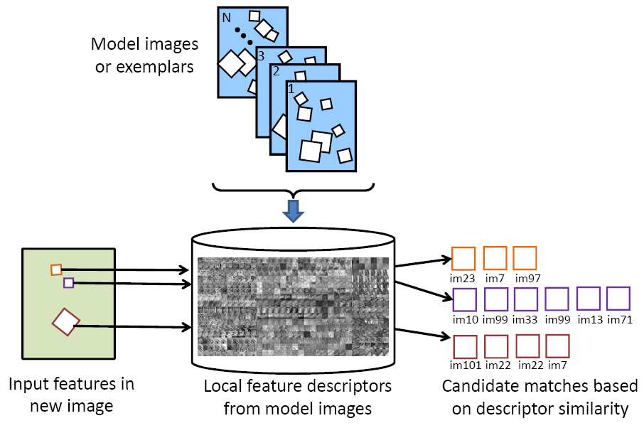
Large-scale image search
Borrow ideas from text indexing and retrieval!
Visual words, inverted indices, stop words, query expansion…
Figure source: K. Grauman and B. Leibe
Sivic & Zisserman (2003), Nister & Stewenius (2006), Philbin et al. (2007), etc.

Slide 25
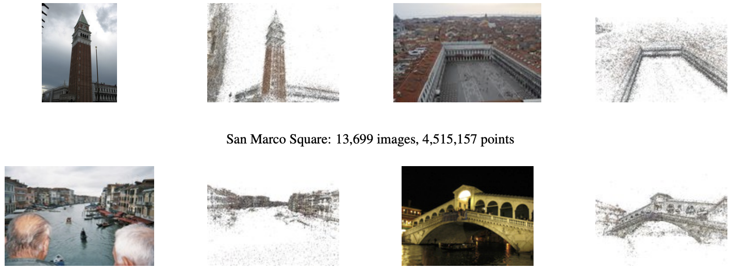
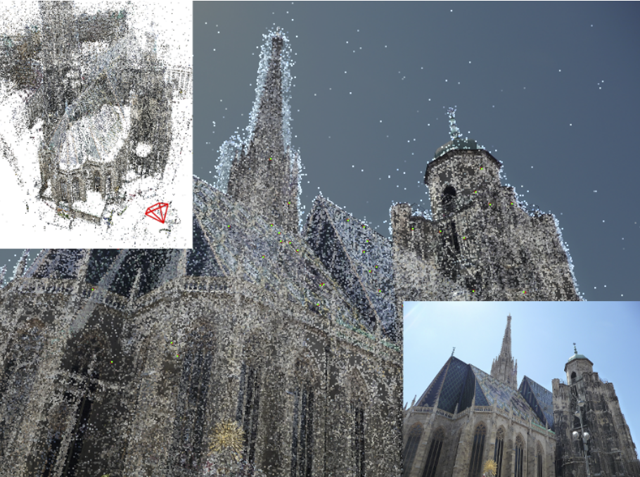
Large-scale image registration, reconstruction
Snavely et al. (2006), Agarwal et al. (2009), Frahm et al. (2012), etc.
Sattler et al. (2011)

Slide 26
1970
1980
1990
2000
Alignment
Invariants
Instances
Aspect graphs
Generalized cylinders

Slide 27
1970
1980
1990
2000
Alignment
Invariants
Instances
Aspect graphs
Keypoints
Generalized cylinders
SIFT
Video Google
Appearance models

Slide 28
Appearance-based methods: Discussion
Summary
In the early- to mid-90’s, people realized that you could use images to represent themselves
This was supported by viewpoint-centric theories of human recognition – see, e.g., Edelman & Weinshall (1990), Tarr & Pinker (1991)
Initial appearance-based models (eigenfaces, appearance manifolds) were global and lacking invariance
In the late 90’s, methods based on local keypoint invariants achieved a good combination of discriminability, robustness and invariance
What went wrong?
Nothing really, except that keypoint detectors and descriptors (and subsequent indexing pipelines) had to be extensively hand-engineered

Slide 29
History of Recognition: Outline
Object instance recognition
Object category recognition
MISSION: ACCOMPLISHED
Texture recognition
Scene recognition

Slide 30
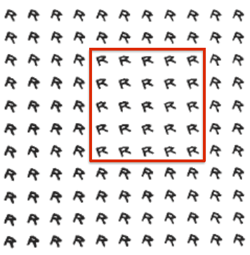
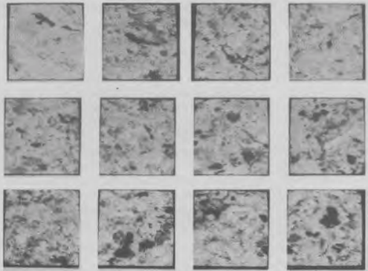
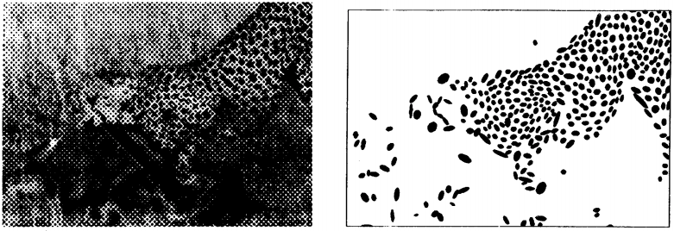




Texture recognition
Statistics of textons
Autocorrelation, co-occurrence functions
Blobs
Julesz (1962, 1981)
Haralick (1979)
Voorhees & Poggio (1987)
K-means clustering, texton vocabularies
Blobs + textons
Filter banks, pyramids
Malik & Perona (1990), Heeger & Bergen (1994)
Leung & Malik (1999)
Lazebnik et al. (2003)
Notes:
Julesz 81 abstract: Research with texture pairs having identical second-order statistics has revealed that the pre-attentive texture discrimination system cannot globally process third- and higher-order statistics, and that discrimination is the result of a few local conspicuous features, called textons. It seems that only the first-order statistics of these textons have perceptual significance, and the relative phase between textons cannot be perceived without detailed scrutiny by focal attention.
Bergen & Adelson abstract: Texture perception has frequently been studied using textures constructed by repeated placement of micropatterns or texture elements. Theories have been developed to explain the discriminability of such textures in terms of specific features within the micropatterns themselves. For example, Beck1,2 observed that a region filled with vertical Ts is readily distinguished from one filled with tilted Ts but not from one filled with vertical Ls. He attributed this to the different distribution of oriented line segments preventing the former case but not in the latter. However, Bergen and Julesz3 found that a region of randomly oriented Xs segregated from one filled with randomly oriented Ls, in spite of the identical distribution of oriented line segments in the two eases. They suggested that this discrimination might be based on the density of such features as terminators, corners, and intersections within the patterns. We note here that simpler, lower-level mechanisms tuned for size may be sufficient to explain this discrimination. We tested this by varying the relative sizes of the Xs and the Ls; when they produce equal responses in size-tuned mechanisms they are hard to discriminate, and when they produce different size-tuned responses they are easy to discriminate.

Slide 31
1970
1980
1990
2000
Alignment
Invariants
Instances
Aspect graphs
Keypoints
Generalized cylinders
SIFT
Video Google
Appearance models

Slide 32
1970
1980
1990
2000
Alignment
Invariants
Instances
Aspect graphs
Keypoints
Generalized cylinders
SIFT
Video Google
Appearance models
Misc. statistics
Textures
Textons
Filter banks
Texton histograms
Bags of features

Slide 33
Texture recognition: Discussion
Summary
Texure recognition was the only sub-field in which statistical methods held sway from the beginning
Dominant model is local statistics or histograms of local appearance
For a long time, this was assumed to be appropriate only for textures
At this point, texture is mainly interesting as part of scenes

Slide 34
History of Recognition: Outline
Object instance recognition
Object category recognition
MISSION: ACCOMPLISHED
Texture recognition
Scene recognition
MISSION: ACCOMPLISHED

Slide 35
Category recognition: Deformable templates
D’Arcy Wentworth Thompson, On growth and form, 1917

Slide 36



Deformable templates
M. Fischler and R. Elschlager, The representation and matching of pictorial structures, IEEE Trans. on Computers, 1973
Notes:
“Suppose there is a mechanism, either a computer program, or possibly a person, or some mechanical device, which, for location xi of the ith component, outputs a numerical value li(xi) that indicates how strongly the ith component fits at location xi of the sensed scene.”

Slide 37


Deformable templates
Active shape models
Yuille (1991)
Cootes & Taylor (1995)

Slide 38

Pictorial structures revived
P. Felzenszwalb and D. Huttenlocher, Efficient matching of pictorial structures, CVPR 2000
P. Felzenszwalb and D. Huttenlocher, Pictorial structures for object recognition, IJCV 2005

Slide 39




Finding people was really hard
Fleck, Forsyth & Bregler (1996)
Ioffe & Forsyth (2001)

Slide 40
Not so today…
F. Bogo, A. Kanazawa, C. Lassner, P. Gehler, J. Romero and M. Black, Keep it SMPL: Automatic Estimation of 3D Human Pose and Shape from a Single Image, ECCV 2016
A. Kanazawa, J. Zhang, P. Felsen, J. Malik, Learning 3D Human Dynamics from Video, CVPR 2019

Slide 41



Constellation models
Burl, Weber, & Perona (1998); Weber, Welling & Perona (2000); Fergus, Perona & Zisserman (2003)
Notes:
Globally different, but have portions in common

Slide 42
1970
1980
1990
2000
Alignment
Invariants
Instances
Aspect graphs
Keypoints
Generalized cylinders
SIFT
Video Google
Appearance models
Misc. statistics
Textures
Textons
Filter banks
Texton histograms
Bags of features

Slide 43
1970
1980
1990
2000
Alignment
Invariants
Instances
Aspect graphs
Keypoints
Generalized cylinders
SIFT
Video Google
Appearance models
Misc. statistics
Textures
Textons
Filter banks
Texton histograms
Bags of features
Deformable templates
Pictorial structures
Probabilistic models
Constellation models
Object categories
Caltech-4
Datasets

Slide 44
Deformable templates: Discussion
Summary
Idea: represent a category as a group of meaningful parts (or primitives) that can deform in some constrained way
Optimize an energy function (possibly derived from a probabilistic formalism) to find the “best” part layout in the image
Such models are also known as part-based and are conceptually similar to primitive-based geometric models of the 70’s and 80’s
What went wrong?
Until the mid-2000s, there were no reliable part (or primitive) detectors

Slide 45





Features and classifiers
Appearance manifolds + neural network
Support vector machines
Neural network
Sung & Poggio (1994)
Osuna, Freund, Girosi (1997)
Rowley, Baluja, Kanade (1998)
Statistics of feature responses, probabilistic classifier
Rectangle features, boosting
Schneiderman & Kanade (1998)
Viola & Jones (2001)

Slide 46
1970
1980
1990
2000
Alignment
Invariants
Instances
Aspect graphs
Keypoints
Generalized cylinders
SIFT
Video Google
Appearance models
Misc. statistics
Textures
Textons
Filter banks
Texton histograms
Bags of features
Deformable templates
Pictorial structures
Probabilistic models
Constellation models
Object categories
Caltech-4
Datasets

Slide 47
1970
1980
1990
2000
Alignment
Invariants
Instances
Aspect graphs
Keypoints
Generalized cylinders
SIFT
Video Google
Appearance models
Misc. statistics
Textures
Textons
Filter banks
Texton histograms
Bags of features
Deformable templates
Pictorial structures
Probabilistic models
Constellation models
Object categories
Features & classifiers
Caltech-4
Datasets
Face datasets

Slide 48



Early 2000’s: Keypoints for everything
Lazebnik, Schmid & Ponce (2003)
Sivic & Zisserman (2003)
Fergus, Perona & Zisserman (2003)

Slide 49



Bags of features
Csurka et al. (2004), Willamowski et al. (2005), Grauman & Darrell (2005), Sivic et al. (2003, 2005)

Slide 50

Implicit shape models
Generalized Hough transform (Ballard, 1981)
B. Leibe, A. Leonardis, and B. Schiele, Combined Object Categorization and Segmentation with an Implicit Shape Model, ECCV Workshop on Statistical Learning in Computer Vision, 2004

Slide 51






















Spatial pyramids
level 0
level 1
level 2
Lazebnik, Schmid & Ponce (2006)

Slide 52

Caltech-101 dataset
http://www.vision.caltech.edu/Image_Datasets/Caltech101/
L. Fei-Fei, R. Fergus, and P. Perona, Learning generative visual models from few training examples: An incremental Bayesian approach tested on 101 object categories, CVPR 2004 Workshop on Generative-Model Based Vision

Slide 53
1970
1980
1990
2000
Alignment
Invariants
Instances
Aspect graphs
Keypoints
Generalized cylinders
SIFT
Video Google
Appearance models
Misc. statistics
Textures
Textons
Filter banks
Texton histograms
Bags of features
Deformable templates
Pictorial structures
Probabilistic models
Constellation models
Object categories
Features & classifiers
Caltech-4
Datasets
Face datasets

Slide 54
1970
1980
1990
2000
Alignment
Invariants
Instances
Aspect graphs
Keypoints
Generalized cylinders
SIFT
Video Google
Appearance models
Misc. statistics
Textures
Textons
Filter banks
Texton histograms
Bags of features
Deformable templates
Pictorial structures
Probabilistic models
Constellation models
Object categories
Features & classifiers
Implicit shape models
Bags of features
Pyramids
Caltech-4
Caltech-101
Datasets
Face datasets

Slide 55




Detection: Histograms of oriented gradients
HOG feature map
Detector response map
Template
*
=
N. Dalal and B. Triggs, Histograms of Oriented Gradients for Human Detection, CVPR 2005

Slide 56

PASCAL VOC dataset
PASCAL VOC Challenge (2005-2012): http://pascallin.ecs.soton.ac.uk/challenges/VOC/
Challenge classes: Person: person Animal: bird, cat, cow, dog, horse, sheep Vehicle: aeroplane, bicycle, boat, bus, car, motorbike, train Indoor: bottle, chair, dining table, potted plant, sofa, tv/monitor
Dataset size (by 2012): 11.5K training/validation images, 27K bounding boxes, 7K segmentations

Slide 57



Discriminative deformable part models
Root filter
Part filters
Deformation weights
P. Felzenszwalb, R. Girshick, D. McAllester, D. Ramanan, Object Detection with Discriminatively Trained Part-Based Models, PAMI 2009

Slide 58

Discriminative deformable part models
P. Felzenszwalb, R. Girshick, D. McAllester, D. Ramanan, Object Detection with Discriminatively Trained Part-Based Models, PAMI 2009

Slide 59
Progress on PASCAL detection
Before CNNs
After CNNs

Slide 60
1970
1980
1990
2000
Alignment
Invariants
Instances
Aspect graphs
Keypoints
Generalized cylinders
SIFT
Video Google
Appearance models
Misc. statistics
Textures
Textons
Filter banks
Texton histograms
Bags of features
Deformable templates
Pictorial structures
Probabilistic models
Constellation models
Object categories
Features & classifiers
Implicit shape models
Bags of features
Pyramids
Caltech-4
Caltech-101
ImageNet
Datasets
Face datasets

Slide 61
1970
1980
1990
2000
Alignment
Invariants
Instances
Aspect graphs
Keypoints
Generalized cylinders
SIFT
Video Google
Appearance models
Misc. statistics
Textures
Textons
Filter banks
Texton histograms
Bags of features
Deformable templates
Pictorial structures
Probabilistic models
Constellation models
DPM
Object categories
Features & classifiers
HOG
Implicit shape models
Bags of features
Pyramids
Caltech-4
Caltech-101
Datasets
Face datasets
PASCAL VOC

Slide 62


Developments after 2010: Selective search for detection
ROI featrures: color SIFT, codebook of size 4K, spatial pyramid with four levels = 360K dimensions
J. Uijlings, K. van de Sande, T. Gevers, and A. Smeulders, Selective Search for Object Recognition, IJCV 2013

Slide 63


Developments after 2010: COCO dataset
http://cocodataset.org/#home

Slide 64



Developments after 2010: Instance-level detection and segmentation
K. He, G. Gkioxari, P. Dollar, and R. Girshick, Mask R-CNN, ICCV 2017 (Best Paper Award)

Slide 65
Category-level recognition: Discussion
Summary
In deep neural networks, deformable templates have converged with features and classifiers, winning the day
We now have clean end-to-end architectures for simultaneously handling instance detection, classification, and segmentation
What went wrong?
We are saturating ImageNet and COCO
We are no closer to understanding what a “category” is – existing label taxonomies are as unsatisfying as ever
Existing datasets and models assume that every category is common and known
We’re still not sure whether our category models need parts or explicit 3D information (more on this tomorrow)

Slide 66


Category-level recognition: What’s next?
3D representations
A. Kanazawa, S. Tulsiani, A. Efros, J. Malik, Learning Category-Specific Mesh Reconstruction from Image Collections, ECCV 2018

Slide 67
History of Recognition: Outline
Object instance recognition
Object category recognition
MISSION: ACCOMPLISHED
Texture recognition
Scene recognition
MISSION: ACCOMPLISHED

Slide 68
Early scene understanding
Slide credit: A. Efros
Approach has everything: color, super-pixels, bottom-up segmentation, top-down parsing, inter- and intra-region reasoning, Bayesian formulation!
Y. Yakimovsky and J. Feldman, A semantics-based decision theory region analyzer, IJCAI 1973

Slide 69



Early scene understanding
A. Hanson and E. Riseman, VISIONS: A computer system for interpreting scenes, Computer Vision Systems, 1978

Slide 70



Early scene understanding
Y. Ohta, Takeo Kanade and T. Sakai, An Analysis System for Scenes Containing objects with Substructures, Proc. of the Fourth International Joint Conference on Pattern Recognition, pp. 752-754, January, 1978

Slide 71

What went wrong?
Slide credit: A. Efros
Ohta & Kanade (1978)

Slide 72
What went wrong?
Slide credit: A. Efros
Ohta & Kanade (1978)

Slide 73

Structured scene representations revisited
Z. Tu, X. Chen, A. Yuille, and S.-C. Zhu, Image Parsing: Unifying Segmentation, Detection, and Object Recognition, ICCV 2003, IJCV 2005
Notes:
Figure 1 illustrates a typical example where a football scene is ﬁrst divided into three parts at a coarse level: a person in the
foreground, a sports ﬁeld, and the spectators. These three parts are further decomposed into nine
visual patterns in the second level: a face, three texture regions, some text, a point process (the
band on the ﬁeld), a curve process (the markings on the ﬁeld), a color region, and a region for nearby
people. In principle, we can continue decomposing these parts until we reach a resolution criterion.
The parsing graph is similar in spirit to the parsing trees used in speech and natural language
processing except that it can include horizontal connections (see the dashed curves in Figure 1)
for specifying spatial relationships and boundary sharing between diﬀerent visual patterns.
From Zhu and Mumford, “A stochastic grammar of images”:
By analogy to natural
language understanding, the task of image parsing….
is to compute a parse graph as the most probable interpretation
of an input image. This parse graph includes a tree-structured
decomposition for the contents of the scene, from scene labels, to
objects, parts, primitives, so that all pixels are explained, and a number
of spatial and functional relations between nodes for contexts at all
levels of the hierarchy.
People who worked on image parsing in the 1960–1970s were, obviously,
ahead of their time. In Kanade’s own words, they had only 64K
memory to work with at that time… The image parsing efforts and structured methods
encountered overwhelming difficulties in the 1970s and since then
entered a hibernation state for a quarter of a century.
The grammar represents both the hierarchical decompositions from scenes,
to objects, parts, primitives and pixels by terminal and non-terminal
nodes and the contexts for spatial and functional relations by horizontal
links between the nodes.

Slide 74



Appearance-based scene representation: GIST
A. Oliva and A. Torralba, Modeling the shape of the scene: A holistic representation of the spatial envelope, IJCV 2001

Slide 75
Appearance-based scene representation: GIST
Matching of scenes based on GIST works surprisingly well – given a large enough dataset
J. Hays and A. Efros, Scene Completion Using Millions of Photographs, SIGGRAPH 2007

Slide 76

Semantic segmentation
MSRC Dataset (2006)

Slide 77


TextonBoost
Label field
Image
Model parameters
Local data term
Smoothing term
J. Shotton, J. Winn, C. Rother, and A. Criminisi, TextonBoost: Joint Appearance, Shape And Context Modeling For Multi-class Object Recognition And Segmentation, ECCV 2006

Slide 78


Scene flow
Top scene matches
Labels
SIFT Flow
Warped matches and labels
Final labels
Ground truth
Test image (SIFT)
C. Liu, J. Yuen, and A. Torralba, Nonparametric Scene Parsing via Label Transfer, PAMI 2011

Slide 79


Semantic segmentation with superpixels
Superpixel features
[After Malisiewicz and Efros, 2008]
J. Tighe and S. Lazebnik, SuperParsing: Scalable Nonparametric Image Parsing with Superpixels, IJCV 2013

Slide 80

Semantic segmentation with superpixels and detectors
[Malisiewicz and Efros, 2011]
J. Tighe and S. Lazebnik, Finding Things: Image Parsing with Regions and Per-Exemplar Detectors, CVPR 2013

Slide 81
Semantic segmentation today: Mask R-CNN
K. He, G. Gkioxari, P. Dollar, and R. Girshick, Mask R-CNN, ICCV 2017 (Best Paper Award)

Slide 82
1970
1980
1990
2000
Alignment
Invariants
Instances
Aspect graphs
Keypoints
Generalized cylinders
SIFT
Video Google
Appearance models
Misc. statistics
Textures
Textons
Filter banks
Texton histograms
Bags of features
Deformable templates
Pictorial structures
Probabilistic models
Constellation models
DPM
Object categories
Features & classifiers
HOG
Implicit shape models
Bags of features
Pyramids
Caltech-4
Caltech-101
ImageNet
Datasets
Face datasets
PASCAL VOC

Slide 83
1970
1980
1990
2000
Alignment
Invariants
Instances
Aspect graphs
Keypoints
Generalized cylinders
SIFT
Video Google
Appearance models
Misc. statistics
Textures
Textons
Filter banks
Texton histograms
Bags of features
Deformable templates
Pictorial structures
Probabilistic models
Constellation models
DPM
Object categories
Features & classifiers
HOG
Implicit shape models
Bags of features
Pyramids
Scenes
Knowledge-based approaches
GIST
Semantic segmentation
Caltech-4
Caltech-101
ImageNet
Datasets
MNIST
Face datasets
PASCAL VOC

Slide 84


Scene understanding: What’s next?
We have challenging standardized benchmarks, though we’re beginning to saturate current datasets (COCO)
Need to push more on 3D and situated scene understanding
A. Kirillov, K. He, R. Girshick, C. Rother, and P. Dollár, Panoptic segmentation, CVPR 2019
M.-F. Chang et al., Argoverse: 3D Tracking and Forecasting with Rich Maps, CVPR 2019

Slide 85
History of Recognition: Summary
Instance recognition
3D geometric
Blocks world
Alignment
Aspect graphs
Invariants
Primitive-based approaches: generalized cylinders, geons
Appearance-based
Eigenfaces
Appearance manifolds
Color indexing
Keypoint-based
Schmid & Mohr
Lowe
Video Google
Texture recognition
Textons
Filter banks
Histograms
Object category recognition
Pictorial structures
Early statistical: Late 90s face detectors
Constellation models
Bags of features
HOG, DPMs
Scene recognition
Early knowledge-based
GIST
Bags of features, pyramids

Slide 86
1970
1980
1990
2000
Alignment
Invariants
Instances
Aspect graphs
Keypoints
Generalized cylinders
SIFT
Video Google
Appearance models
Misc. statistics
Textures
Textons
Filter banks
Texton histograms
Bags of features
Deformable templates
Pictorial structures
Probabilistic models
Constellation models
DPM
Object categories
Features & classifiers
HOG
Implicit shape models
Bags of features
Pyramids
Scenes
Knowledge-based approaches
GIST
Semantic segmentation
Duda & Hart
“Patterns”
Neocognitron
LeCun et al. digit rec.
LeNet-5
Back-propagation
Caltech-4
Caltech-101
ImageNet
Datasets
MNIST
Face datasets
PASCAL VOC

Slide 87

CNN vs. hand-crafted pipelines

Slide 88





Convolution as feature extraction
bank of K filters
K feature maps
...
image
feature map

Slide 89



Normalization and spatial pooling
Image pixels
SIFT features
Apply oriented filters
Filter with Visual Words
Take max filter response (L-inf normalization)
Take max VW response (L-inf normalization)
Multi-scale spatial pool
(Sum)
Spatial pool (Sum), L2 normalization
SIFT features
Image descriptors
Source: R. Fergus
Notes:
Note pooling is across space, not across Gabor channel
Normalization is really nonlinear (small elements not rescaled)

Slide 90
Deformable part models as CNNs
P. Felzenszwalb, R. Girshick, D. McAllester, D. Ramanan, Object Detection with Discriminatively Trained Part-Based Models, PAMI 2009

Slide 91

Deformable part models as CNNs
R. Girshick, F. Iandola, T. Darrell, and J. Malik, Deformable Part Models are Convolutional Neural Networks, CVPR 2015

Slide 92
In general, what were the “big ideas”?
Optimization – not procedural reasoning
Rich descriptors of pixel values – not simple point and line features
Data and learning – not rules
Discriminative classifiers – not just probabilistic models
Sliding window operations and spatial pooling
Deformable templates

Slide 93
Where did we go wrong?
Computer vision had several periods of “spinning its wheels”
We’ve always prioritized methods that could already do interesting things over potentially more promising methods that could not yet deliver
We’ve undervalued simple methods, data, and learning
When nothing worked, we distracted ourselves with fancy math
We’ve had some problems with bandwagon jumping and intellectual snobbery
On a few occasions, we unaccountably ignored methods that later proved to be “game changers” (RANSAC, SIFT)
But it’s not clear whether any of it mattered in the end…

Slide 94
Lana’s MVP’s (Most Valuable Papers)
Hough transform – Duda & Hart, 1972
Pictorial structures – Fischler & Elschlager, 1973
RANSAC – Fischler & Bolles, 1981
Edge detection – Canny, 1986
Corner detection – Harris & Stephens, 1988
Normalized 8-point algorithm – Hartley, 1997
Graph cuts – Boykov et al., 2001
Face detection with boosting – Viola & Jones, 2001
SIFT – Lowe, 2004
Deformable part models – Felzenszwalb et al., 2010

Slide 95
What did my historical survey omit?
Image filtering
Wavelets, steerable filters, bilateral filtering…
Biologically inspired low-level representations (Olhausen & Field, etc.)
Generation methods
E.g., texture generation (Heeger & Bergen, Efros & Leung, etc.)
Image-based modeling and computational photography
Dense reconstruction, stereo
Graphical models craze
Perceptual organization

